Slide 1
Physical Conditioning
Advice for Club/Regional Coaches
Notes:
1

Slide 2
Aims
To review essential components of orienteering fitness and their development
To outline the key conditioning sessions in the week – what, how and when
To practically demonstrate a typical ‘terrain’ session, appropriate to development of ‘O’ specific fitness
Notes:
2

Slide 3
Components of Fitness
Endurance
Strength
Muscular Endurance – Resisting fatigue in long races
Motor Fitness
Power
Speed – Final stages of sprint race
Anaerobic Capacity – Maintain high pace for duration of race
Core Strength – Maintaining running form in terrain
Agility/Co-ordination – Moving between trees
Dynamic Balance – Maintaining form across terrain
Strength – Maintaining pace up hills
Aerobic Capacity – Maintain consistent pace for duration of race
Dynamic Flexibility – Crossing barriers
Notes:
3

Slide 4
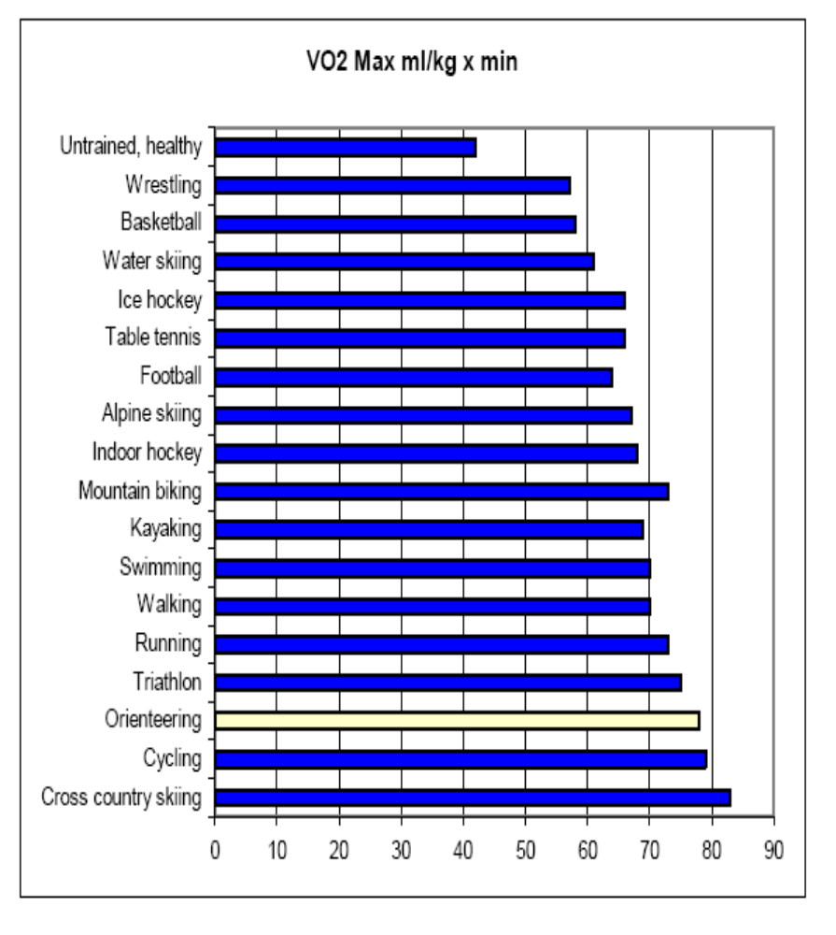
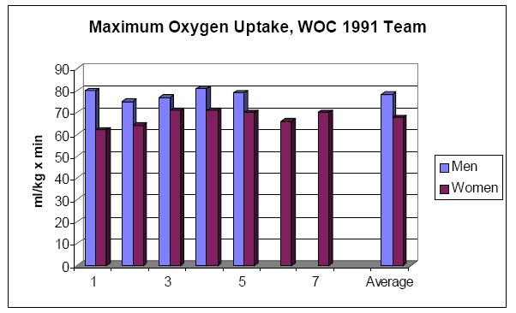
Why aerobic capacity?
Notes:
4

Slide 5
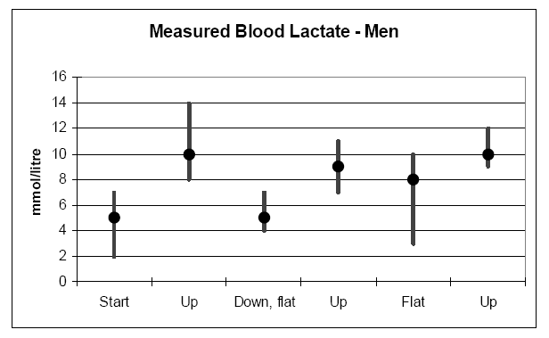
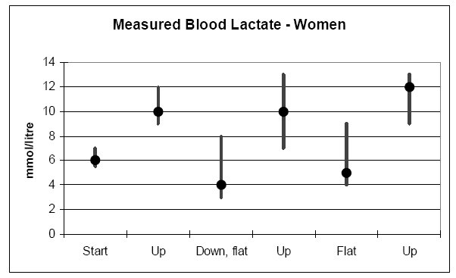
Why anaerobic capacity?
Notes:
5

Slide 6
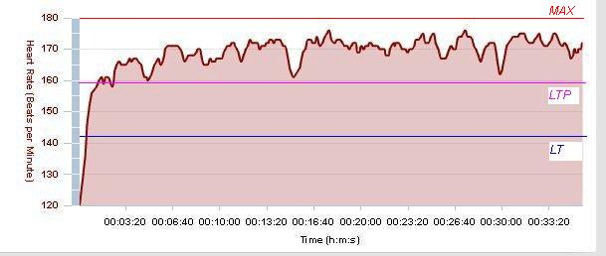
More evidence....
Notes:
6

Slide 7
WHAT – THE OVERALL FOCUS
PRIMARY
Aerobic – Development of VO₂ max
Threshold – Development of AT/lactate tolerance
SECONDARY
Anaerobic – Development of speed/power
Strength – Development of muscular endurance/offset local fatigue/strength ‘in terrain’
Rest – ‘Train hard; rest hard’
Notes:
7

Slide 8
HOW – THE 3 CORE SESSIONS
Aerobic – Steady state, ~70-80% max, 40-90mins
AT – Tempo/long intervals (>500m), 80-90% max, 30-45mins
Anaerobic – Hills/Short intervals (<500m), 90%+ max, 25-35mins
Ideally – SPECIFIC, ie. in ‘terrain’, (with map & compass occasionally), esp. pre-season
Other – Core, circuits, weights, flex, cross & REST
Notes:
8

Slide 9
WHEN – PERIODISED TRAINING
Phase | Easy / Recovery (<70%) | Steady (70-80%) | Tempo / Threshold (80-90%) | Speed Endurance / Anaerobic (>90%)
Off Season (Sept) | *** | ** | --- | ---
Pre-Season: Base 1/Prep (Oct) | *** | *** | * | ---
Pre-Season: Base 2/Volume (Nov/Dec) | ** | *** | ** | *
Pre-Season: Specific (Jan/Feb) | * | ** | *** | **
key session
Notes:
9

Slide 10
TODAY’S PRACTICAL
Opportunity to engage in a typical ‘terrain’ session, working on aerobic/anaeroic mix
Show how coaches/athletes can easily devise their own sessions
Practically experience current trends in warming up – cv, stretching, drills
Q&A throughout! pmurgatroyd@lincoln.ac.uk

Slide 11
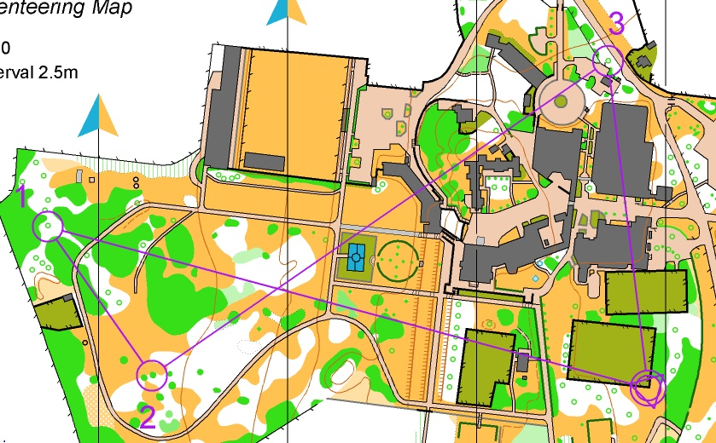
TODAY’S PRACTICAL SESSION
Groups A-E: Intervals
Intensity – 80-90% max
Duration - 30-40mins
Work – ~2-3mins (~4-600m)
Recovery – ~1-2mins (~2-300m) @ 50-60% max
Plan loop of 2 work and 2 recovery legs
Common start shown on map
Focus should be running NOT navigation
Notes:
11

Slide 12
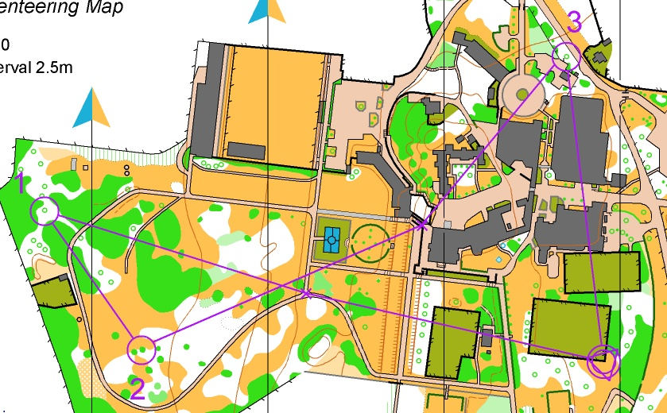
TODAY’S PRACTICAL SESSION
Groups T-Z: Fartlek
Intensity – 70-90% max
Duration - 30-40mins
Work – Variable legs (~2 - 400m each leg) of 2 paces (70-80 and 80-90%max)
Recovery – ~1-200m @~50-60% max
Plan loop of 2 work and 2 recovery legs, with pace change marked by red X
Common start shown on map
Focus should be running NOT navigation
Notes:
12

Slide 13
INTENSITY – THE CONUNDRUM
Intensity can be calculated via:
  Rate of perceived exertion, ie. 70% = Conversational level
  Times derived from time trial, eg. 3000m
  HR monitoring (Age related max, Karvonen, Field testing)
  Lab testing – gold standard

Slide 14
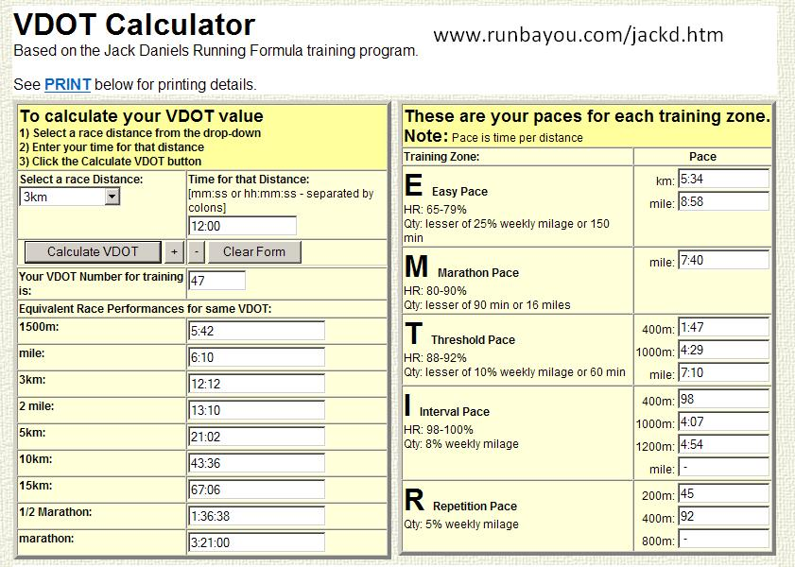
INTENSITY – DANIEL’S TABLES
Using HR monitoring:
  Take resting HR (ideally in morning)
  Take max HR (ideally from max test)
  Max-Rest=Reserve (HRR)
  Take 10% of HRR and use to subtract from Max
  Work through zones required, ie. 60;70;80 & 90%max
Notes:
14

